Slide 1
OCAP Reference Implementation – CableLabs tru2way Workbench
October 29, 2008

Slide 2
tru2way WB Phase 0 Status
Completed
Branched ODL Stack for December Phase 0 release
Designed tru2way branding assets (icon, welcome screen, remote, front panel, …)
Merged enableTV’s VWB Perforce mainline into CableLabs SVN branch
Fixed Ant and InstallShield release build environment
Identified Test Plan for validating release candidates
Built VWB snapshot to begin testing release branch
In Progress
Update copyright in Client Simulator code with “open source” verbiage (waiting on legal)
Remove enableTV Help plugin and documentation
Modify VWB feature plugin
Update copyright in Eclipse and Headend Simulator code with “open source” verbiage
(waiting on legal)
Update Eclipse plugins about text and plugin info text (waiting on legal)
Update splash screen and icons in source (verify with legal)
Update Vidiom Remote and Front Panel images in source (verify with legal)
Update Welcome Eclipse plugin (verify with legal)
Update release notes
Update version fields
Build an InstallShield release
Test release distribution

Slide 3
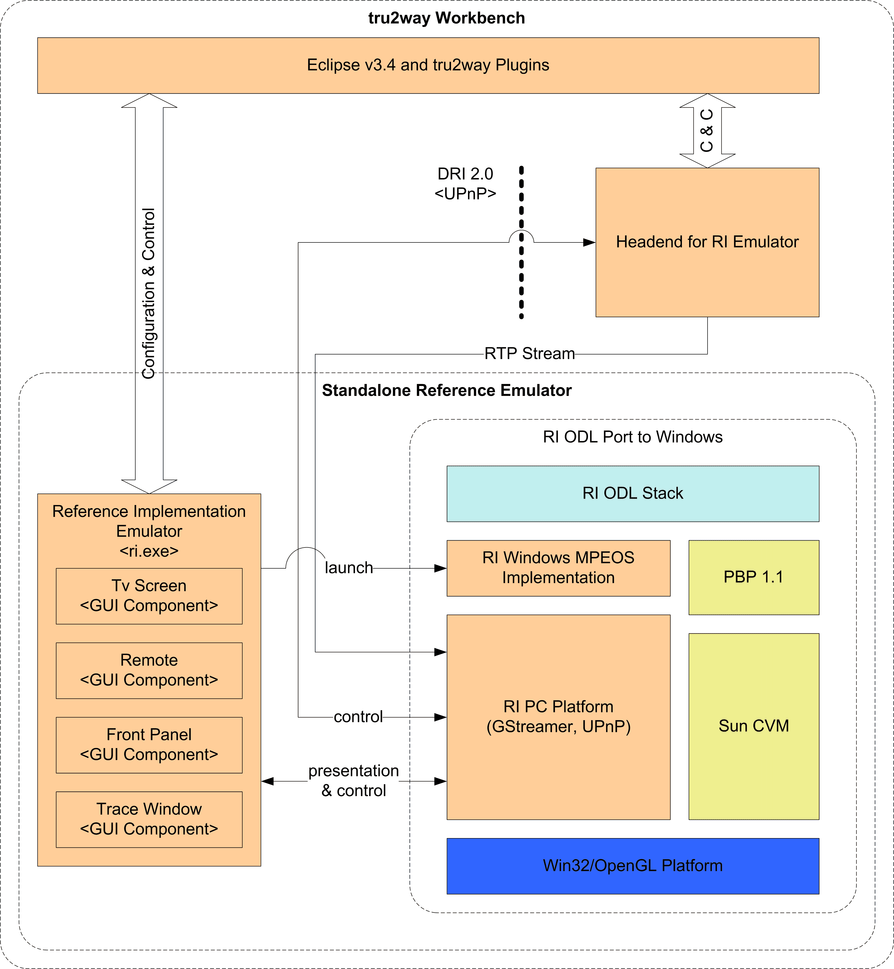
tru2way Workbench Architecture

Slide 4
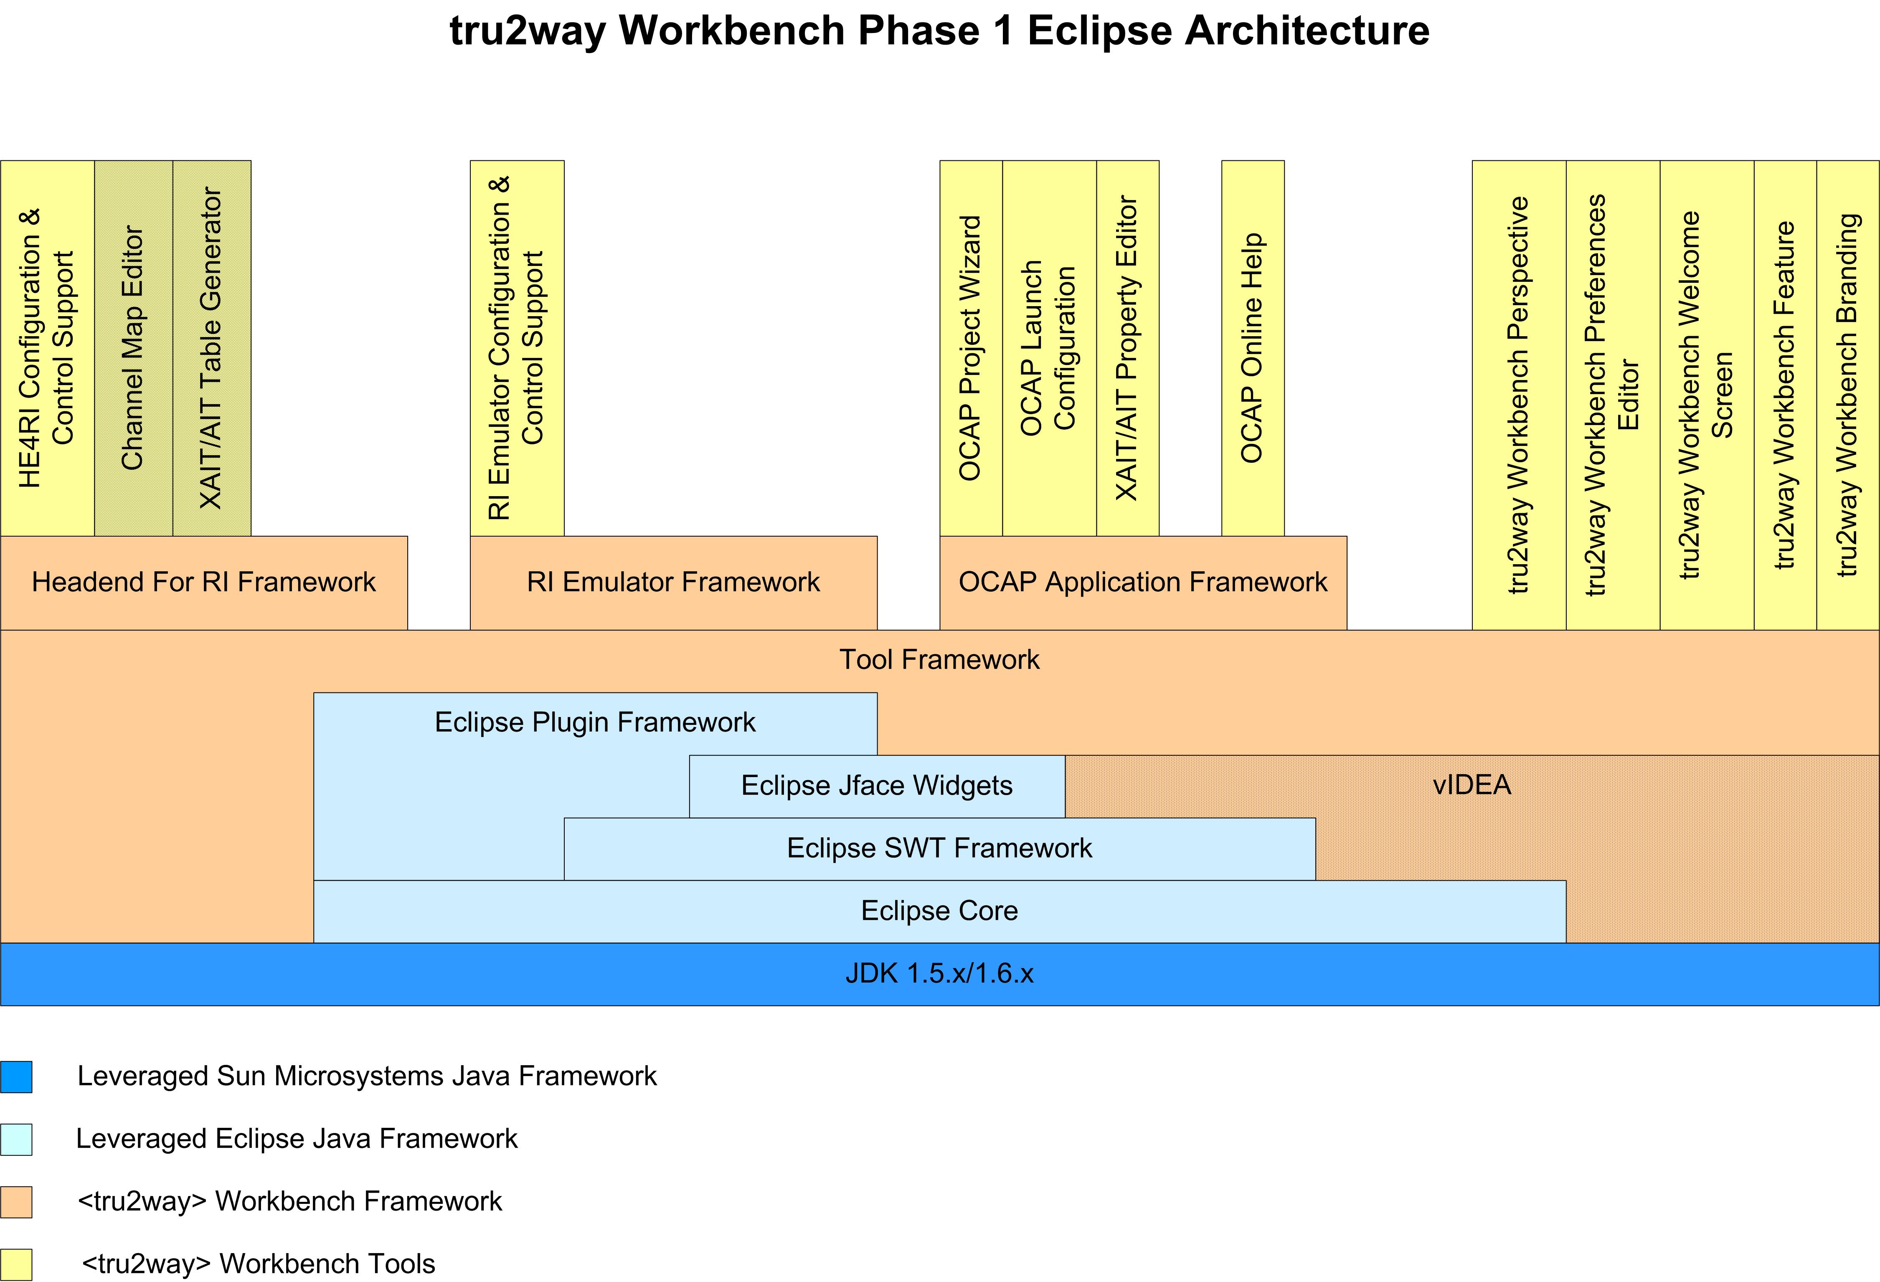
tru2way Workbench cont.

Slide 5
tru2way WB Phase 1 Features
RI Emulator
IDE and standalone configuration supported
All OCAP application types supported (Bound/Unbound)
Executes in Run and Debug modes
Provide virtual TV Screen, Remote and Set-top Front Panel for user presentation and IO
  Full-screen Windows monitor support
  Support for following coherent device configurations: 640x480 – 4:3, 960x540 – 4:3,
  640x480 – 16:9, and 960x540 – 16:9
  Show/hide graphics and video planes
Messages from ODL stack and application captured in external log as well as displayed in Console UI
  Console can be paused/resumed
  Output can be filtered based on category and level
Configurable STB hardware emulation
Supports multiple instances of emulator on the same PC (?)
Integrated with Eclipse launch configuration manager as part of OCAP Project workflow

Slide 6
tru2way WB Phase 1 Features
Headend For RI Emulator (HE4RI)
Delivers MPEG-2 Transport Streams for audio/video play back
  One or more elementary stream
  Pre-recorded files and live transport streams
Delivers PAT/PMT InBand via Transport Stream
Delivers SI OOB
  Pre-defined sections
Tuning support by [frequency, QAM, program] tuple as well as source ID
XAIT signaling via file configuration (i.e. xait.properties consumed directly by stack)
XAIT table generation (if schedule permits)
AIT signaling via file configuration (i.e. ait-1234.properties consumed directly by stack)
AIT table generation (if schedule permits)
Channel Map Editor (if schedule permits)
Initiate/terminate pre-recorded EAS message
Integrated with Eclipse launch configuration manager as part of OCAP Project workflow

Slide 7
tru2way WB Phase 1 Features
IDE Workflow Feature
Based on Eclipse v3.4 JDT technology
Create project workspace for application development
Provide application template: Simple and HelloWorld
Provide default OCAP Stack configuration, is customizable
Provide default RI Emulator configuration, is customizable
Provide default HE4RI Emulator configuration, is customizable
Project-specific configuration
  Application specific properties
  XAIT and AIT generation
  GPNVS configuration (if schedule permits)
  FDC configuration via Channel Map (if schedule permits)
  Tuner configuration (if schedule permits)
Launch configurations for both Run and Debug modes
Welcome screen
Tools perspective organization
OCAP Project import/export

Slide 8
tru2way WB Phase 1 Features
ATE Feature
Ability to send key codes via network/socket
TBD – Gather input from CTP Testing Team
Home Networking Feature
TBD – Gather input from Flashlight Engineering and Consulting Team

Slide 9
tru2way WB Phase 1 Project Mgmt
Resources
1 full-time engineer on the RI Emulator GUI
  Needs C/C++ and UI experience (Qt/GTK++/wxWidgets/Win32)
  Needs Microsoft Windows development experience
  iTv experience desired
1 full-time engineer on the HE4RI IDE integration
  Needs C/C++ and Java experience
  Needs experience in Cable TV technology
  Needs Microsoft Windows development experience
  Some UI experience with Swing and/or SWT
  Eclipse plug-in experience would be good
1 full-time engineer on the RI Emulator integration and IDE Workflow modifications
  Needs C/C++ and Java experience
  Needs Microsoft Windows development experience
  Some UI with Swing and/or SWT
  Eclipse plug-in experience would be good
  iTv experience desired
Schedule
6 – 8 months in parallel with current RI development team

Slide 10
tru2way WB Release Issues
Licensing (enableTV, ODL, Sun)
Past VWB releases required Sun Tck validation of stack. This has not been completed with current RI ODL Stack and Sun CVM.
Release process uses InstallShield 7 which is no longer supported. InstallShield scripts and release build will need to be updated to current product offering (InstallShield 2008/09).
How much time will be spent testing each release distribution? Who will do this besides the RI development team?
How will source be bundled for open source distribution?
How will build environment be structured for the open source release?
What will be the support structure? Online Help? Support web site? Wiki?

